Slide 1
MCV-M2:
Image Inpainting and Completion
Team 7 - Joan F. Serracant, Martí Cobos.

Slide 2
Week 3: Image segmentation

Slide 3
Index
Task 1: Chan-Vese algorithm
Task 2: Implementation of Chan-Vese algorithm
Task 3: Test algorithm with given images
Task 4: Video with curve evolution
Task 5: Under which assumptions Chan-Vese works?
Task 6: Test our own images
Conclusions

Slide 4
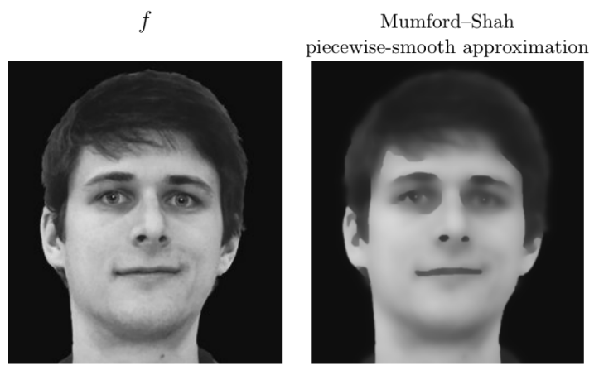
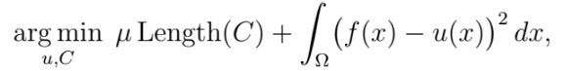
Task 1: Chan-Vese algorithm
Chan-Vese method is inspired by the Mumford-Shah model, which approximates an image f by a piecewise-smooth function u as the solution of:
where contour C is an edge set used as the segmentation boundary.
The model is complicated and computationally expensive so Mumford and Shah propose a simplification by changing smoothness criteria by:
Criteria: C must be a set of closed curves
Criteria: color is constant inside every closed curve
and
Minimum length criteria to avoid jagged edges
Similarity criteria
Smoothness criteria within image domain except for the contour
Minimum length criteria to avoid jagged edges
Similarity criteria
Source: Pascal Getreuer, Chan-Vese Segmentation, Image Processing On Line, 2 (2012), pp. 214–224.

Slide 5
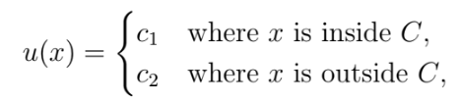
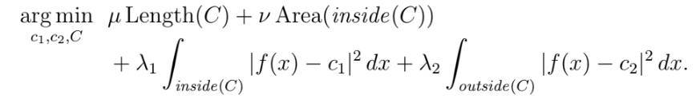
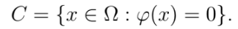
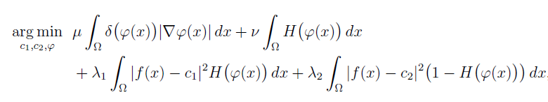
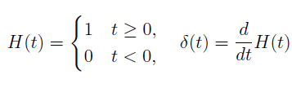
Task 1: Chan-Vese algorithm
Chan-Vese propose new criteria:
u is allowed to have only 2 values
and
To simplify the problem they use Level Set Functions. Contour C can be expressed in terms of a level set function 𝜑 so Now we are dealing with a function over x instead of a set of curves.
New function to minimize using level sets:
Minimum area inside contour criteria
Minimum length criteria to avoid jagged edges
Similarity criteria inside C
Similarity criteria outside C
Where:
Source: Pascal Getreuer, Chan-Vese Segmentation, Image Processing On Line, 2 (2012), pp. 214–224.

Slide 6
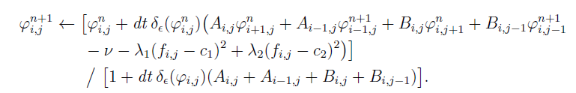
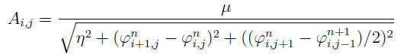
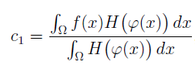
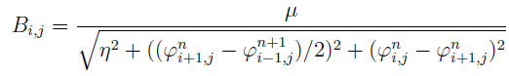
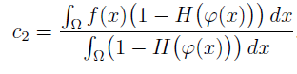
Task 1: Chan-Vese algorithm
Chan-Vese Numerical implementation for gradient descent:
Where the coefficients must be computed as:
Source: Pascal Getreuer, Chan-Vese Segmentation, Image Processing On Line, 2 (2012), pp. 214–224.

Slide 7
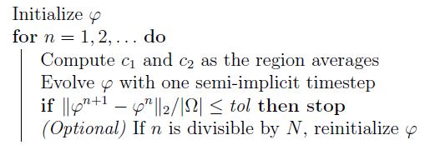
Task 2: Implementation of Chan-Vese algorithm
Code implementation based on paper proposal:
In start.m file level sets is initialized as:
[X, Y]=meshgrid(1:nj, 1:ni); %%Initial phi phi_0=(-sqrt( ( X-round(ni/2)).^2 + (Y-round(nj/2)).^2)+50);
Level Set initialization:
In sol_ChanVeseIpol_GDExp.m file gradient descent algorithm is implemented, firstly c₁, and c₂ are computed as mean of area inside/outside the contour:
%Fixed phi, Minimization w.r.t c1 and c2 (constant estimation) c1 = sum(I(phi(:)>=0))/sum(phi(:)>=0); %TODO 1: Line to complete c2 = sum(I(phi(:)<0))/sum(phi(:)<0); %TODO 2: Line to complete
C₁ and C₂ computation:
Source: Pascal Getreuer, Chan-Vese Segmentation, Image Processing On Line, 2 (2012), pp. 214–224.

Slide 8
Task 2: Implementation of Chan-Vese algorithm
Afterwards A and B matrices are computed for gradient descent implementation:
%Boundary conditions phi(1,:) = phi(2,:); %TODO 3: Line to complete phi(end,:) = phi(end-1,:); %TODO 4: Line to complete phi(:,1) = phi(:,2); %TODO 5: Line to complete phi(:,end) = phi(:,end-1); %TODO 6: Line to complete %Regularized Dirac's Delta computation delta_phi = sol_diracReg(phi, epHeaviside); %notice delta_phi=H'(phi) %derivatives estimation %i direction, forward finite differences phi_iFwd = DiFwd(phi, hi); %TODO 7: Line to complete phi_iBwd = DiBwd(phi, hi); %TODO 8: Line to complete %j direction, forward finitie differences phi_jFwd = DjFwd(phi, hj); %TODO 9: Line to complete phi_jBwd = DjBwd(phi, hj); %TODO 10: Line to complete %centered finite diferences phi_icent = (phi_iFwd+phi_iBwd)./2; %TODO 11: Line to complete phi_jcent = (phi_jFwd+phi_jBwd)./2; %TODO 12: Line to complete %A and B estimation (A y B from the Pascal Getreuer's IPOL paper "Chan %Vese segmentation A = mu./(sqrt(eta^2+phi_iFwd.^2+phi_jcent.^2)); %TODO 13: Line to complete B = mu./(sqrt(eta^2+phi_icent.^2+phi_jFwd.^2)); %TODO 14: Line to complete
Boundary conditions:
function y = sol_diracReg( x, epsilon ) % Dirac function of x % sol_diracReg( x, epsilon ) Computes the derivative of the heaviside % function of x with respect to x. Regularized based on epsilon. y = epsilon./(pi*(epsilon^2+x.^2)); %TODO 19: Line to complete
Regularized Dirac’s Delta computation:
A and B matrices estimation::

Slide 9
Task 2: Implementation of Chan-Vese algorithm
Finally, gradient descent is applied using semi-implicit Gauss-Seidel method:
for i = 2:size(phi,1)-1 for j = 2:size(phi,2)-1 phi(i,j) = ( phi_old(i,j) + ... (dt * delta_phi(i,j) * ... ( ... ( A(i ,j ) * phi_old(i+1,j ) ) + ... ( A(i-1,j ) * phi (i-1,j ) ) + ... ( B(i ,j ) * phi_old(i ,j+1) ) + ... ( B(i ,j-1) * phi (i ,j-1) ) - ... nu - ... (lambda1 * (I(i,j) - c1)^2) + ... (lambda2 * (I(i,j) - c2)^2) ... ) ... ) ... ) ... / ... ( 1.0 + (dt * delta_phi(i,j) * (A(i,j) + A(i-1,j) + B(i,j) + B(i,j-1)) ) ) ; %TODO 15: Line to complete end end

Slide 10
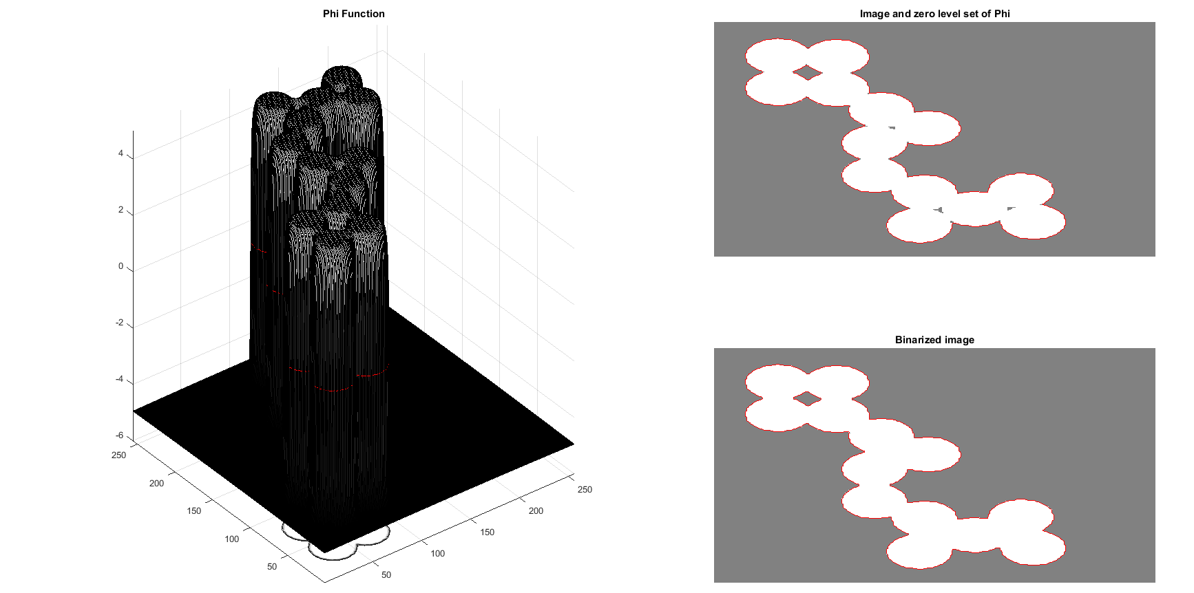
Task 3: Test algorithm with given images
“Circles” image segmentation result:
Image has been segmented correctly and output image is very close to initial image

Slide 11
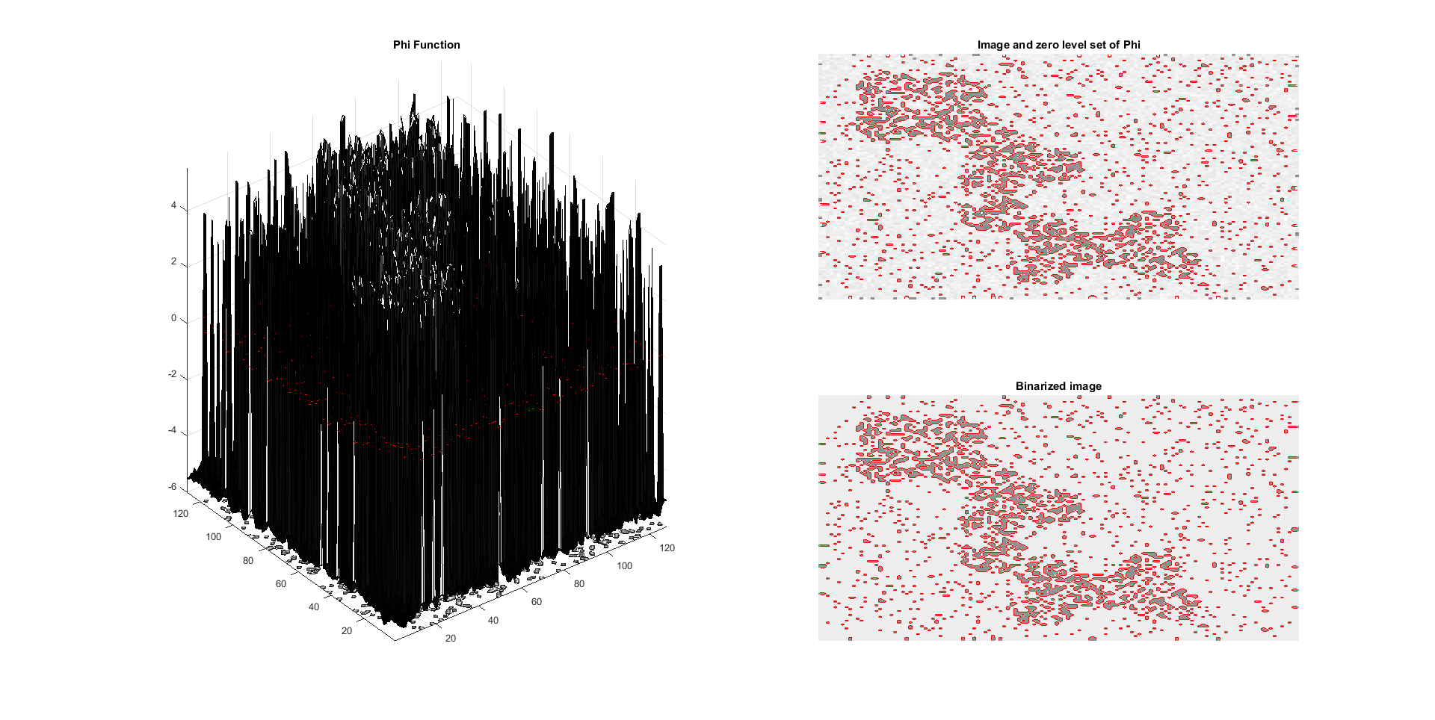
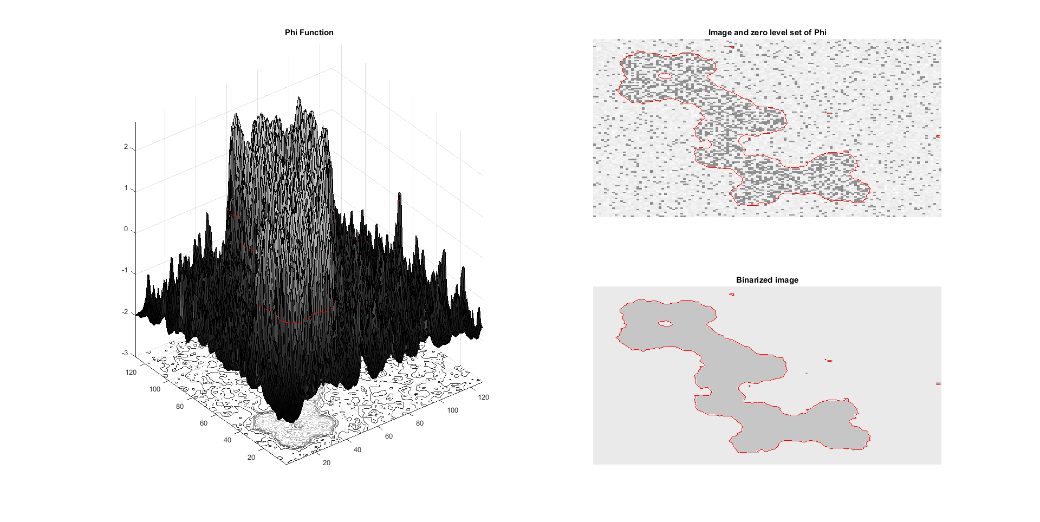
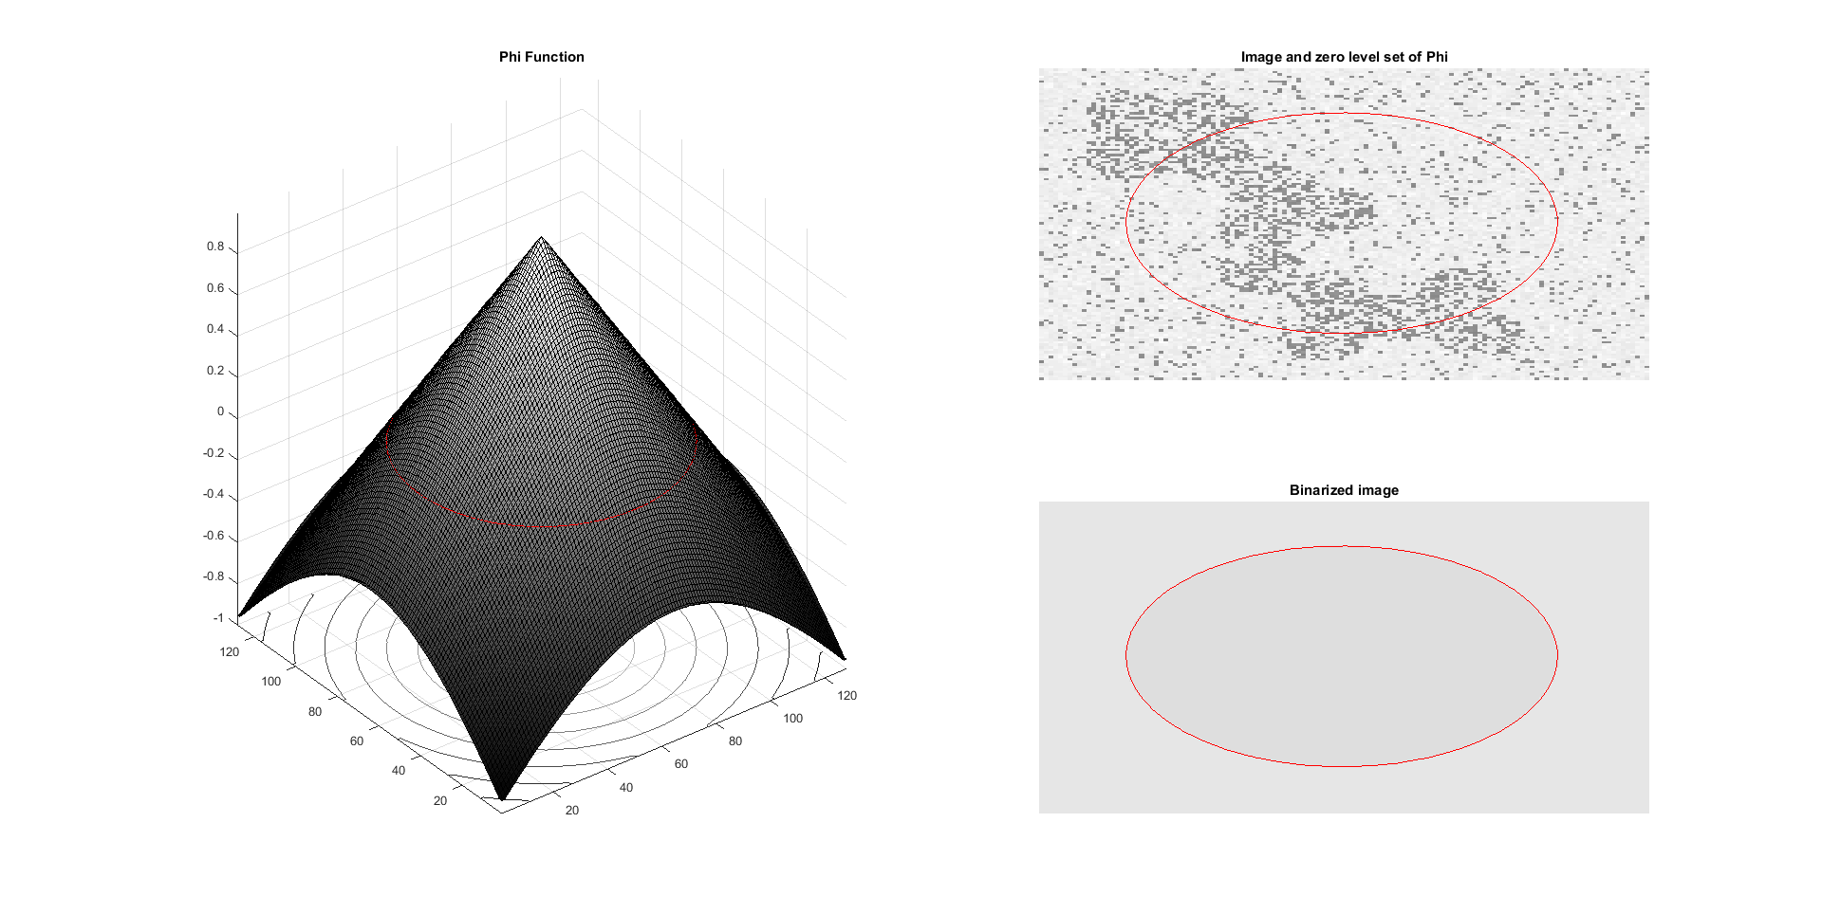
Task 3: Test algorithm with given images
“NoisyCircles” image segmentation shows poor result if algorithm not optimized
In order to have good segmentation results, optimizations parameters must be improved. For this image, the following parameters were used:
mu = 0.25
nu = 0.0001

Slide 12
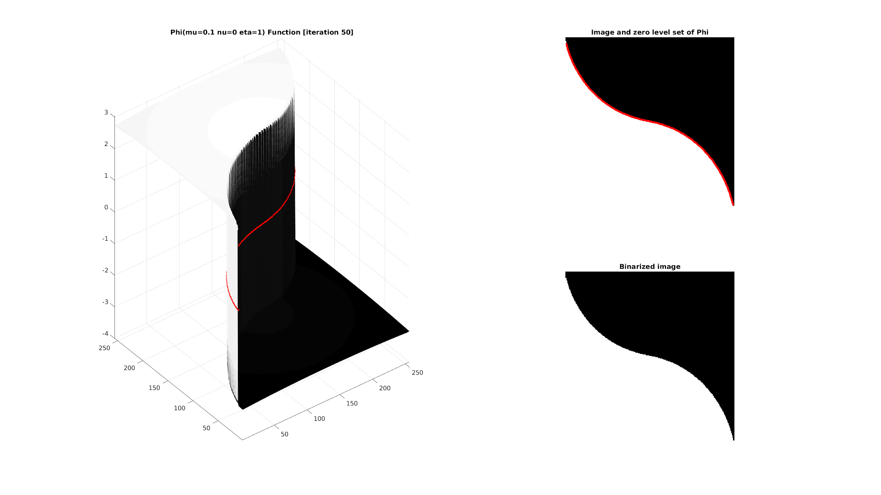
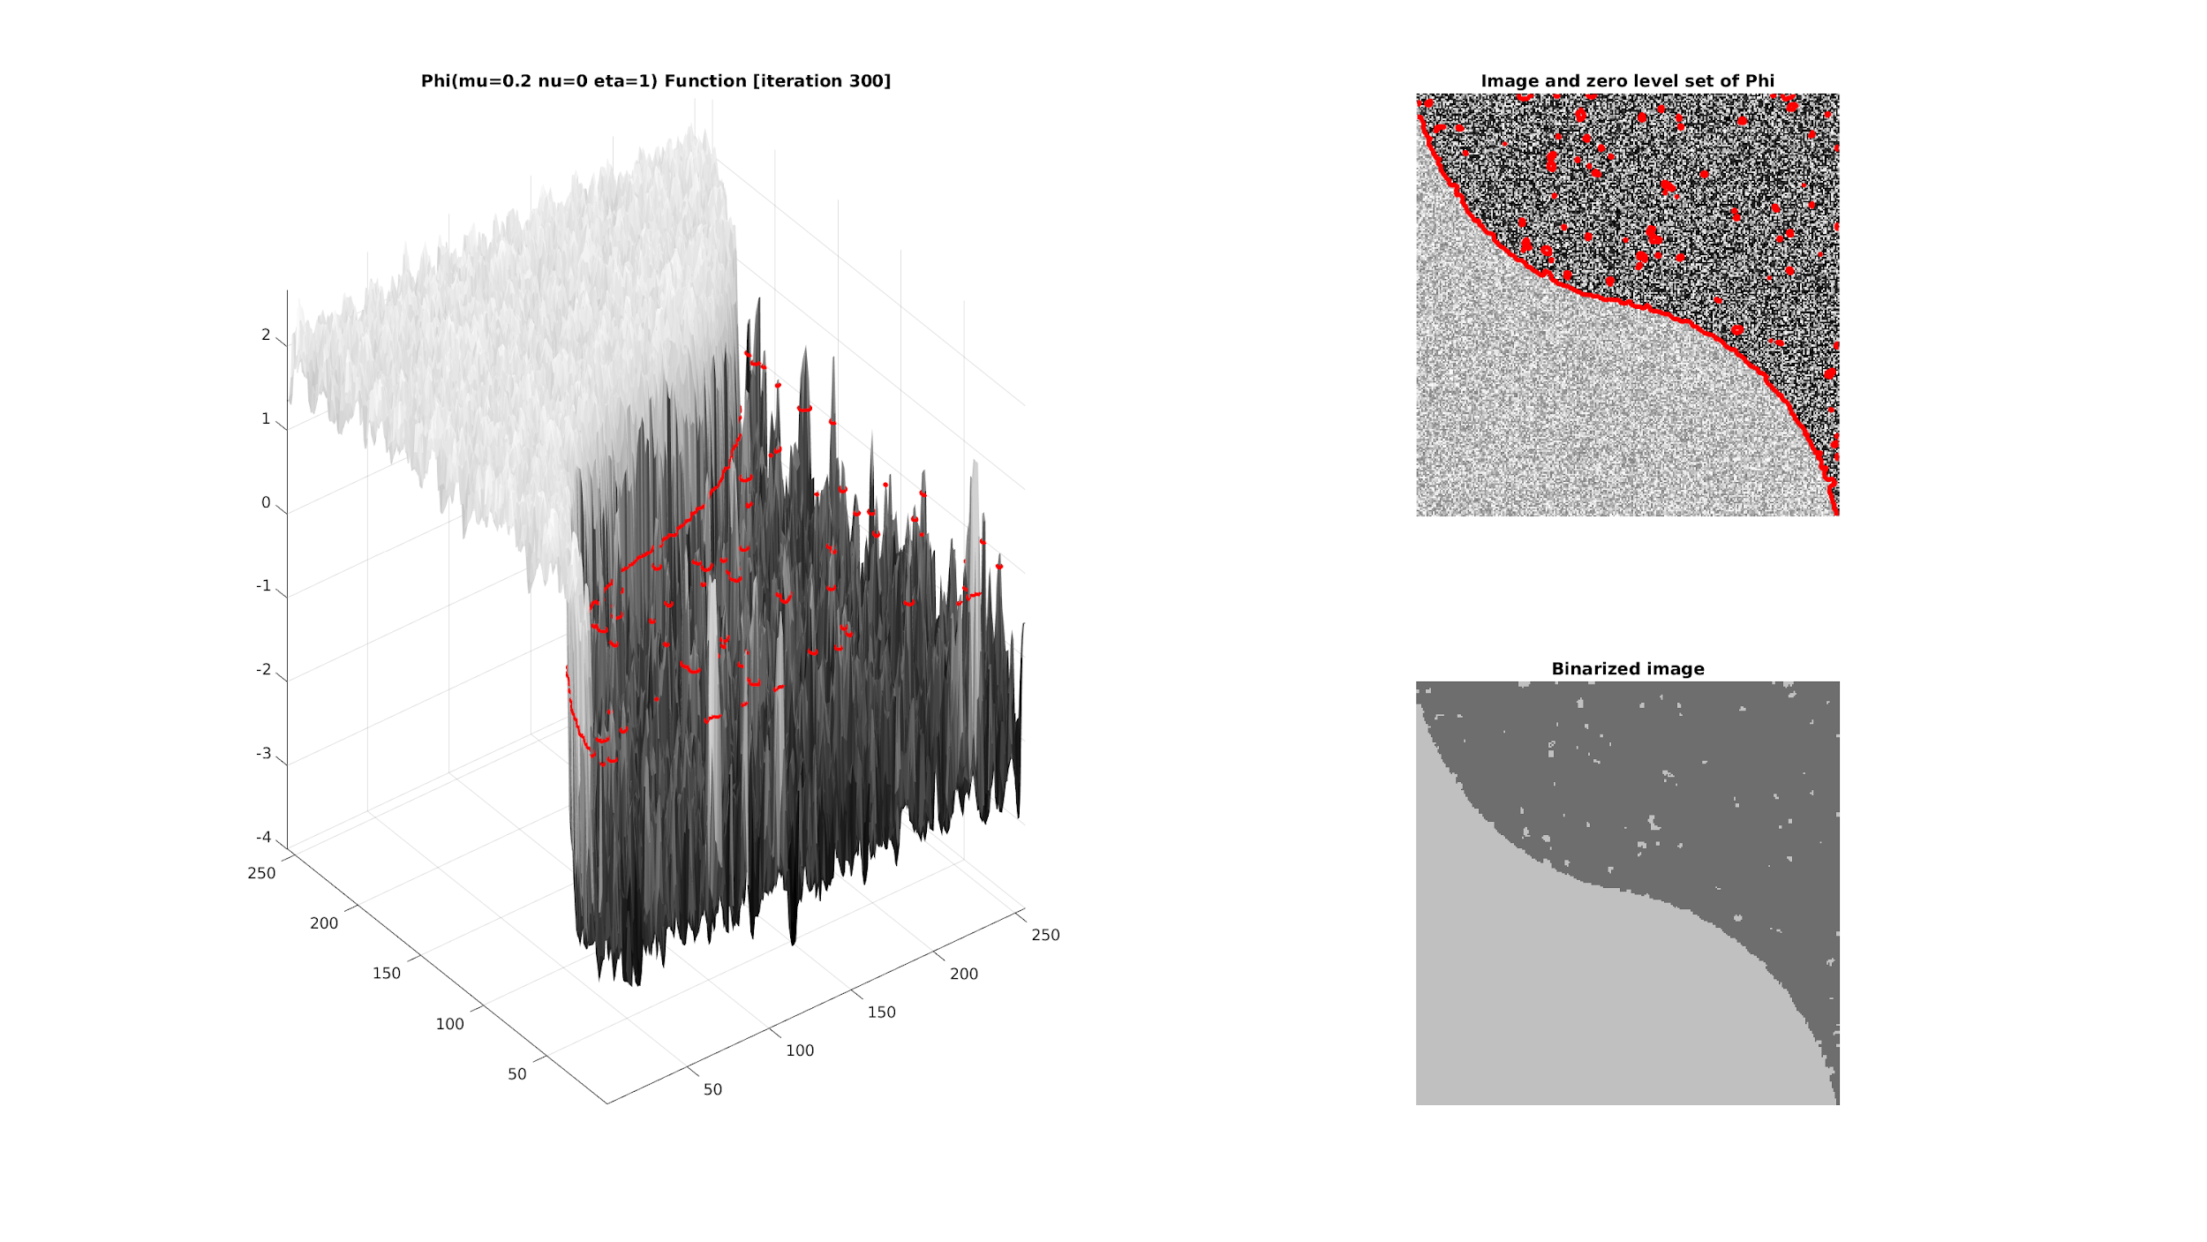
Task 3: Test algorithm with given images
““Phantom17” image can be segmented correctly with little parameter optimization
Although the amount of noise in “Phantom18” segmentation can be achieved

Slide 13
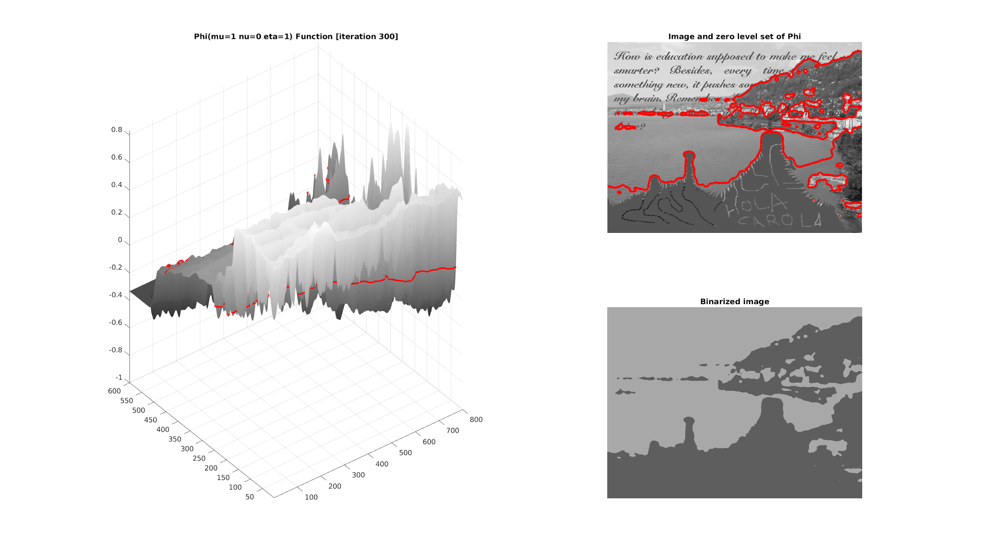
Task 3: Test algorithm with given images
“Image_to_Restore” with 𝝋 = I

Slide 14
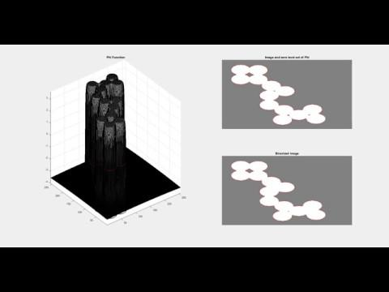
Task 4: Video with curve evolution

Slide 15

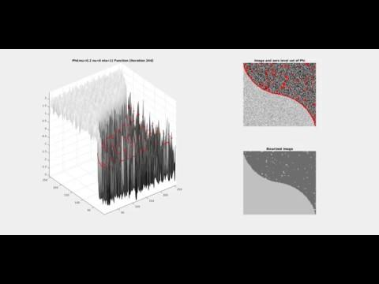
Task 4: Video with curve evolution
We mostly worked with the 𝝋 provided but we also tried with the 𝝋 proposed by the paper

Slide 16
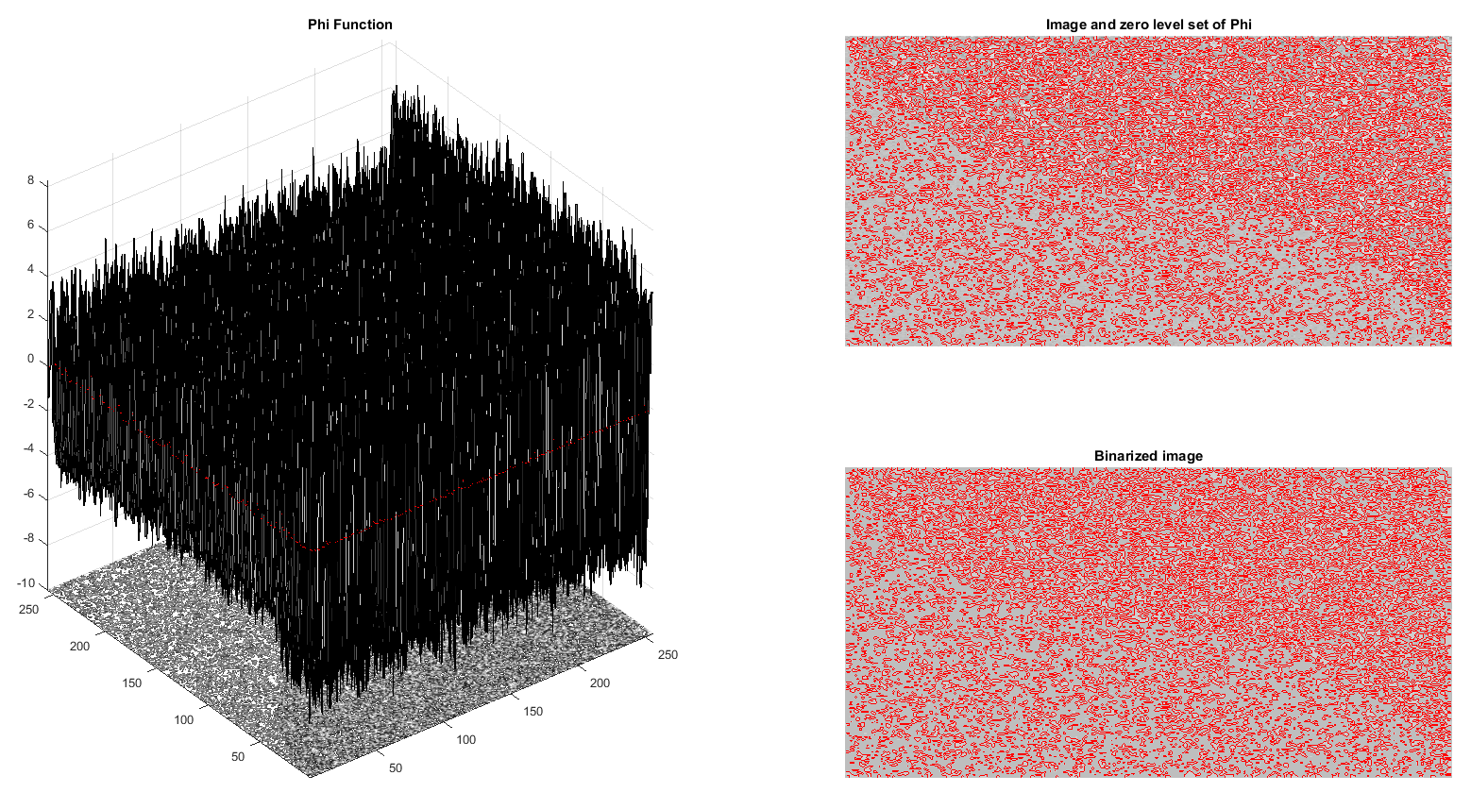
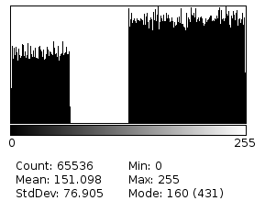
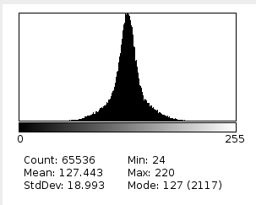
Task 5: Under which assumptions Chan-Vese works?
“Phantom19” may seem quite similar than “Phantom18” but it cannot be segmented correctly, as mean values for each segment are similar due to the noise on the image
The reason is that, although the amount of noise is similar, in “Phantom19” the mean grayscale value for both areas is the same (see the histograms below)
Phantom18 histogram
Phantom19 histogram (both areas with the same mean)
As Chan-Vese segmentation depends on the mean values c₁, c₂ of the two segmented areas, it can only work on the assumption that the mean value of areas to be segmented must be different.

Slide 17
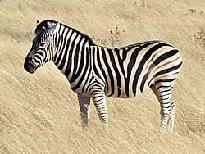
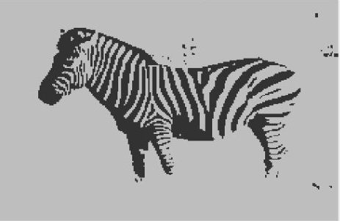
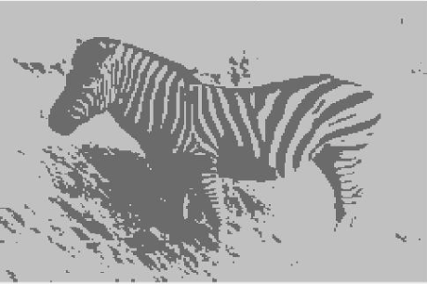
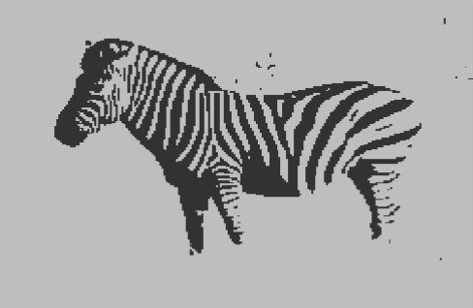
Task 6: Test our own images
For detailed images, using 𝝋 = I shows faster convergence
# iter | Initial 𝝋 | 𝝋 = I
50
100

Slide 18
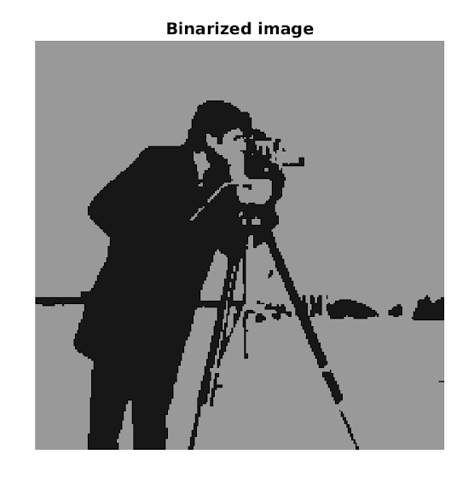

Task 6: Test our own images

Slide 19
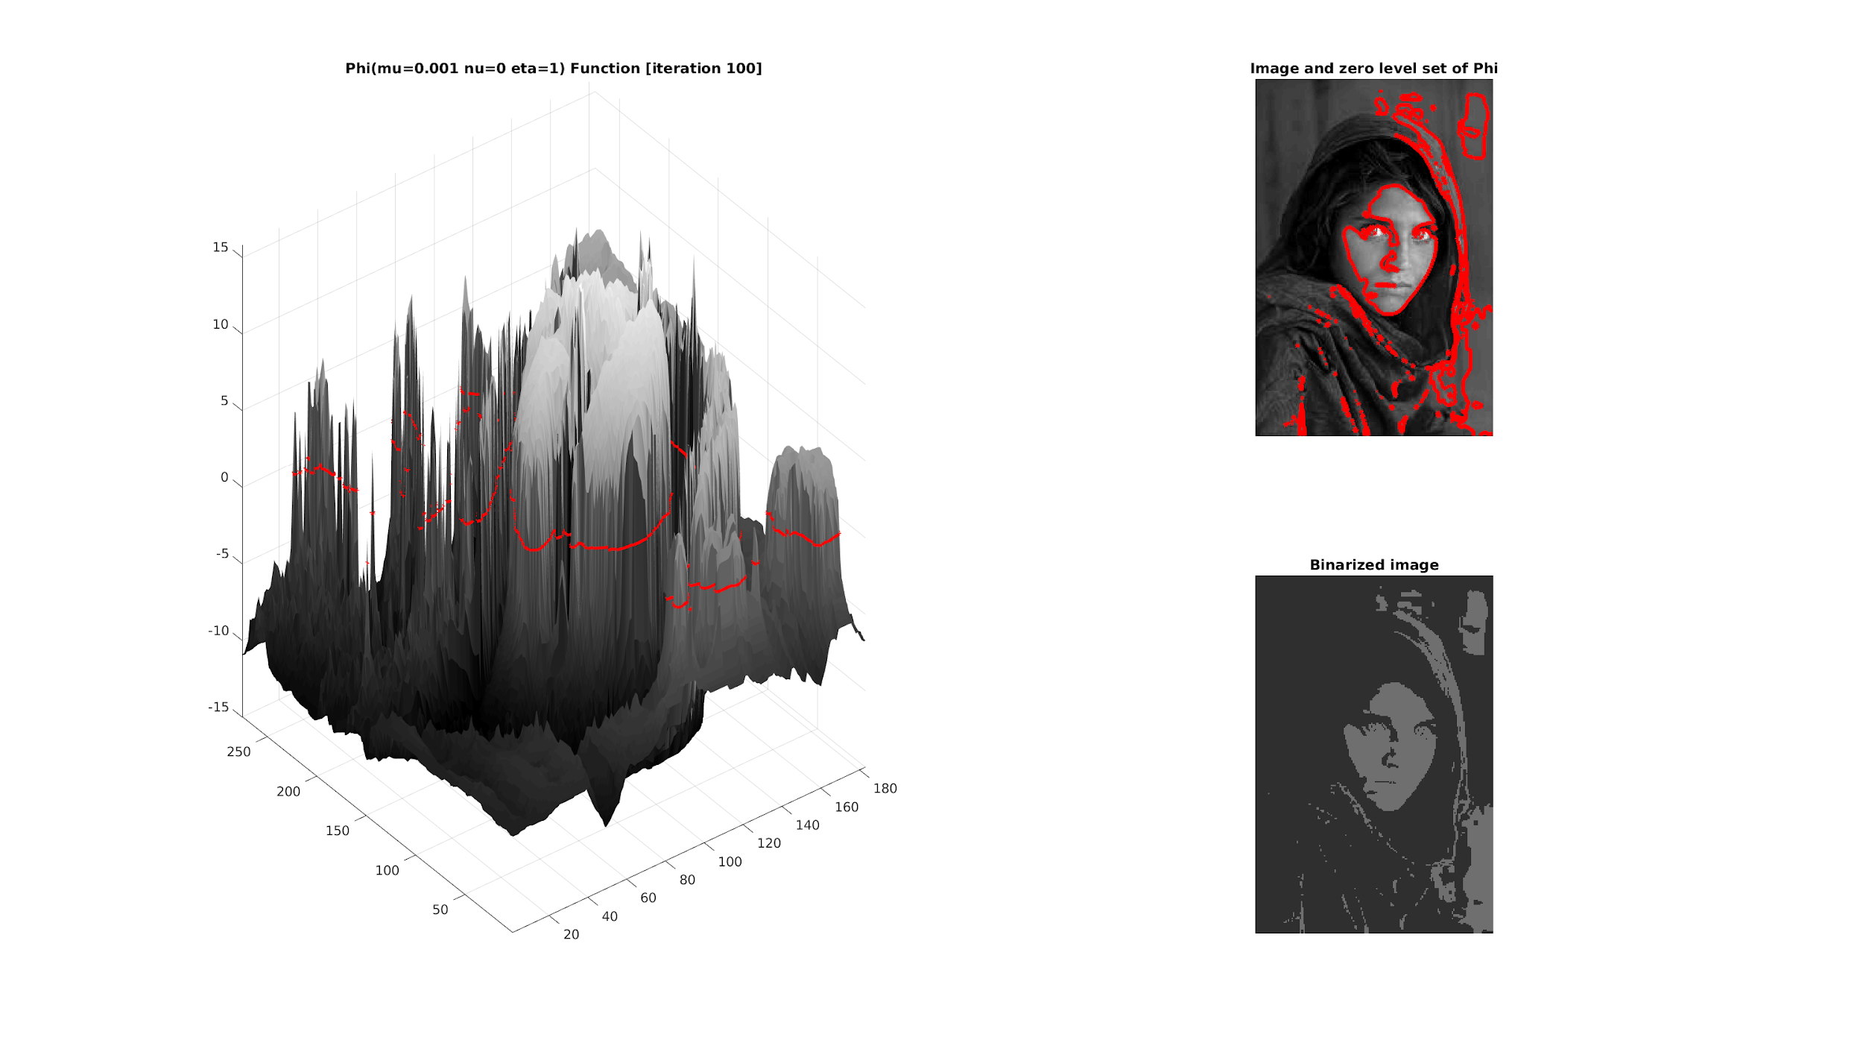
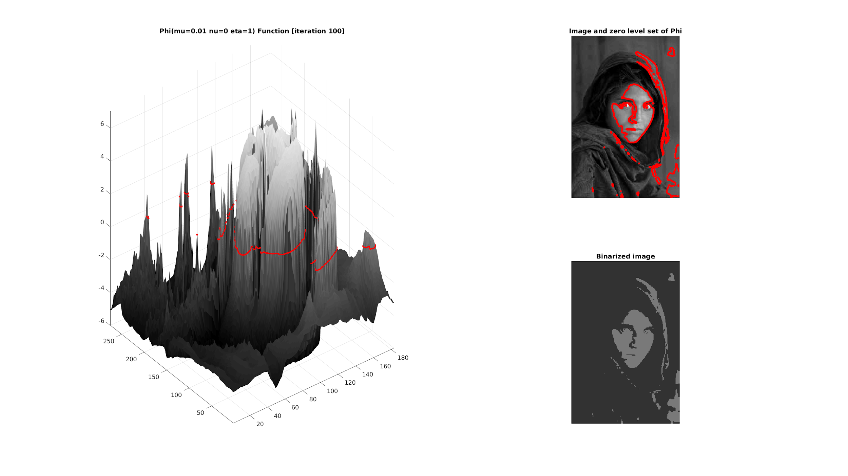
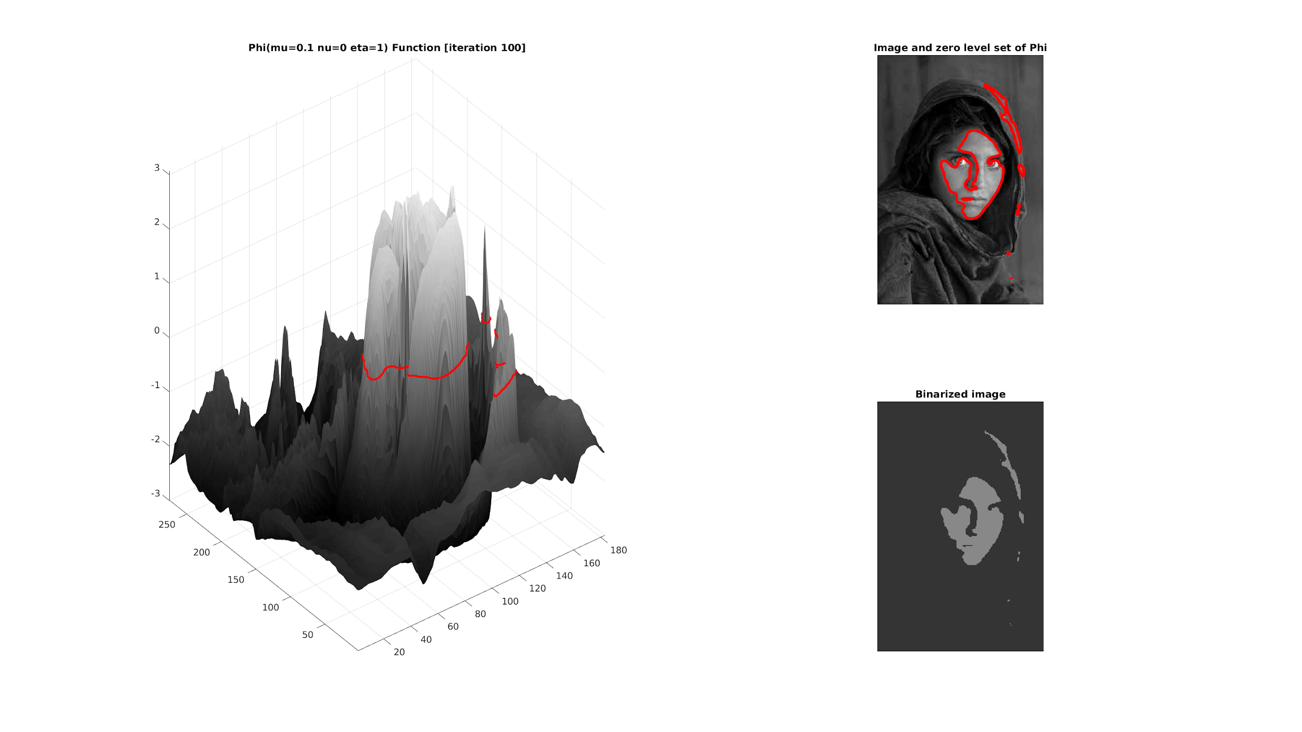
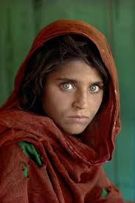
Task 6: Test our own images
μ = 0.1
μ = 0.01
μ = 0.001
μ as a factor to control length of the contour

Slide 20
Conclusions
When an image contains noise, Chan Vese algorithm parameters should be optimized in order to generate a good image segmentation.
Chan Vese algorithm doesn’t work properly if image mean values of regions to be segmented are similar. In other words if the image histogram is unimodal it will not be segmented properly.
RGB images can be processed by converting them to grayscale and segmenting the converted image. Binarized image can be reconstructed by averaging the 3 image channels.

